Slide 1
CHILD & YOUTH
EVANGELISM

Slide 2
WHAT IS CHILD &YOUTH
EVANGELISM
Evangelism is a greek word “EVANGELLION”
It means good news of salvation from God to our children
The great commission children and youth, future leaders has their rightful place in God’s kingdom
Everyone needs salvation e.g child, youth and Adult

Slide 3
GROWTH PATTERN IN CHILDREN & YOUTH
LUKE CHAPTER 1 VS 52
Jesus Christ our role Model
MENTAL DEVELOPMENT=WISDOM
PHYSICAL DEVELOPMENT=STATURE
SOCIAL DEVELOPMENT=FAVOUR WITH MEN
SPRITUAL DEVELOPMENT= FAVOUR WITH GOD

Slide 4
BIBLICAL BASIS OF CHILD & YOUTH EVANGELISM
(a)God words teaches child evangelism and children respond more readily to the message of salvation than any other group
(b) 2 institutions God ordained for child evangelism
(i)The family Deuteronomy 6 vs 6 to 9
(ii)The Church Mathew 28 vs 20
(c)6 Basis of child evangelism from Psalm 78
(1)God commanded it
(2)They will know him
(3)They will set their hope in God
(4)They will keep his commandment
(5)They establish a testimony in Christ
(6)They will not forget the word of God

Slide 5
WHY LEAD CHILDREN & YOUTH TO CHRIST
God loves them John 3 vs. 16
They too have sinned Romans 3 vs. 23
God does not want children to perish Matt18 vs. 14
It is God’s command and promise of salvation Acts2 vs. 38 to 39
Children have more productive years ahead to serve Christ
Children are the future, leaders of tomorrow to Judges2 vs. 10

Slide 6
AN AMERICA SURVEY ON CHILD & YOUTH EVANGELISM
1% Are saved before 4 years old
4% are saved after 30years of age
10% are saved between ages 15 and 30years of age
85% are saved between ages 7 and 14 years of age.

Slide 7
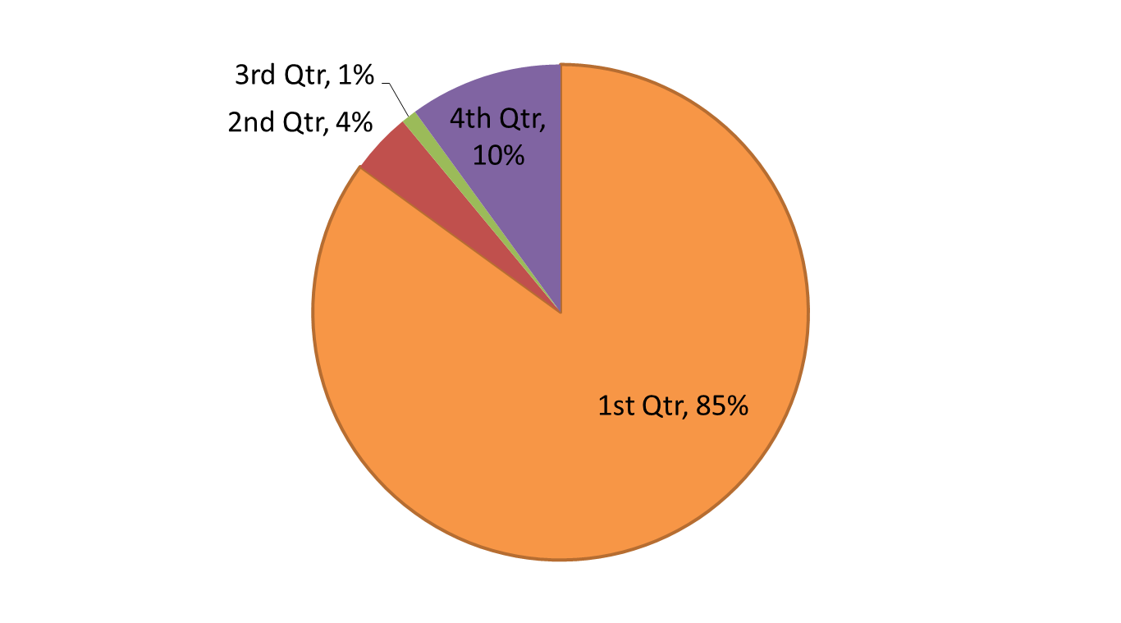
CHILD & YOUTH EVANGELISM CHART

Slide 8
PERIOD OF TRANSITION AND COUNSELLING SESSIONS
Age 7 to 12 years old = Foundational years
Age 13 to 19 years old=Period of transition
Age 19 years upward=Adult life
Counseling sessions=Mark 10 vs 17
Pray for and trust the holy spirit to show you the child’s needs
Put the child at ease
Do not rush through your counseling session
Use the word of God

Slide 9
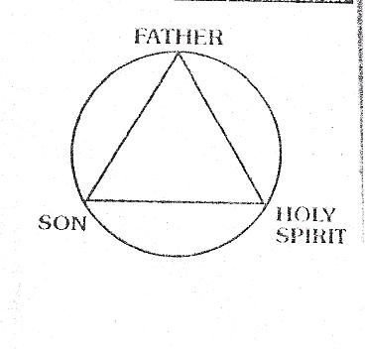



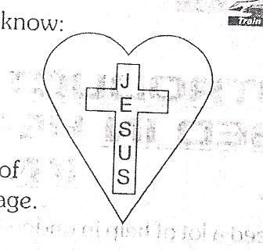
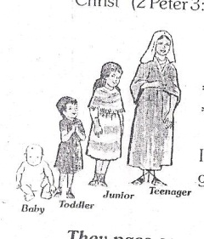
6 BASIC STEPS TO CHILD & YOUTH EVANGELISM
Teach the child about God and Heaven
Expose the child to his sinful nature
Teach the way of salvation
Challenge the child to make a decision of acceptance
Assure the child of his new life
Encourage the child to Grow

Slide 10
PRACTICAL APPROACH TO CHILD & YOUTH EVANGELISM
MASS EVANGELISM
OPEN AIR CRUSADE
CHILDREN BIBLE CLUB
CAMP MEETING
HOLIDAY BIBLE CLUBS
MISSIONS CLUB
READERS CLUB

Slide 11
TEACHING AIDS FOR CHILD & YOUTH EVANGELISM
Visual aids e.g Pictures,
The Cross,
The Wordless Book
The Gospel Hand
Teaching aids e.g Tape Recorders
Projectors
Print Media
Social Media

Slide 12
SAMPLES OF CHILD & YOUTH EVANGELISM
TIMOTHY 2 timothy 1 vs 1 to 5
RHODA Acts 12 vs 13 to 16
NAAMAN’S MAID 2kings 5 vs 2 to 3
SAMUEL 1 Samuel 3 vs 1 to 11
DAVID 1 Samuel 16 vs 1 to 13
ADAM CLERK Bible Commentators
MATHEW HENRY

